Slide 1

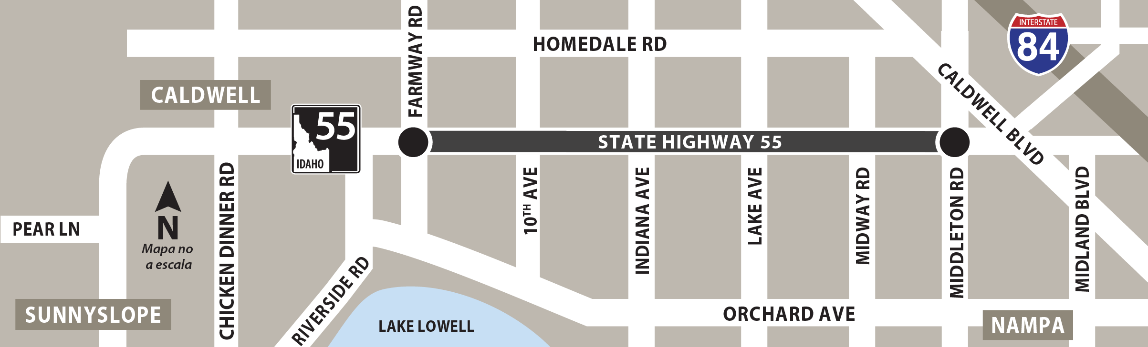

Pre-Advertisement Presentation
SH-55, Farmway Rd to Middleton Rd
Widening Project
(KN 22715)
June 10, 2024

Slide 2

Disclaimer
The information in the following slides is presented to the contracting community to increase awareness of the upcoming advertisement of the SH-55, Farmway Rd to Middleton Rd widening project.
Information within these slides are not contractual.
The only contractually binding materials are the bid documents when the project is advertised.
All quantities are approximate and subject to change prior to advertisement.

Slide 3
Agenda
Safety Topic
Welcome Remarks
Introductions
SH-55 Project Overview and Scope
Key Dates and Timeframes
Questions

Slide 4

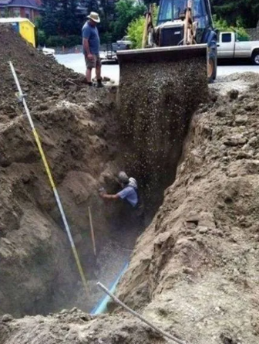
Safety Topic
Situational Awareness
Observe what is happening around you
Comprehend the situation you are experiencing
Anticipate what is likely to occur next
Factors that reduce Situation Awareness
Rushing through a task
Mental or physical fatigue
Complacency
Poor communications
STOP - LOOK - ASSESS - MANAGE
Notes:
Situational Awareness means paying attention and being aware of what’s going on around you. No matter what your role is at work, situational awareness is an important key to keeping everyone safe.
When you practice situational awareness at work, you remain alert and aware of things like:
where your co-workers are while they are working and what they are doing, where operational heavy equipment is and how it is moving, what are the safe procedures for the tasks you are completing, what is going on above and behind you
what is the weather like, if you are working outdoors.
STOP - Think before you act. Consider the task and make sure you understand what needs to be done.
LOOK - Carefully observe the work area to find potential hazards.
ASSESS - Evaluate the hazards and make sure you have the proper tools, training, and PPE to be safe.
MANAGE - Make changes, ask questions, and take the actions you need to continue to work safely.

Slide 5
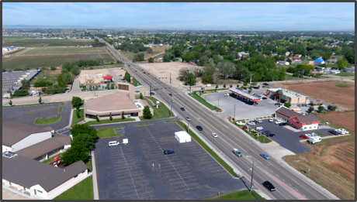
Welcome
The Idaho Transportation Department is widening
SH-55 from Farmway Road to Middleton Road
in Canyon County starting in Fall 2024.

Slide 6
Team Introductions
Dan McElhinney
Chief Deputy Director/COO
Amy Schroeder
Division Administrator
Eric Staats
TECM Program Manager
Erika Bowen
Project Manager, Design
Jason Brinkman
District 3, District Engineer
Shawna King
District 3 Engineering Manager
Andrew Linder
Design/Construction Resident Engineer
Toby Griffin
Project Manager, Construction

Slide 7
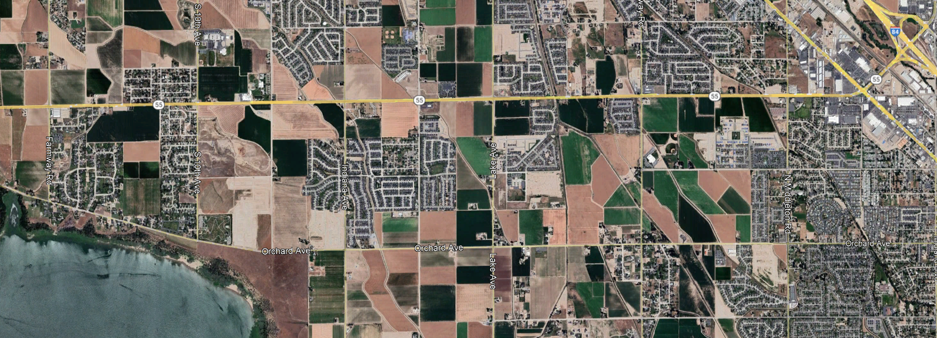
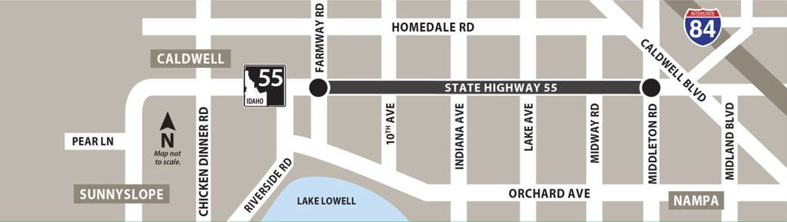
Location
District 3
City of Caldwell
City of Nampa
Canyon County
SH-55
MP 10.6 – MP 15.6
Approx. 5.0 miles long
Karcher IC
Farmway Rd
Middleton Rd

Slide 8
Proposed Improvements
Roadway Improvements
Additional lane in each direction, wider shoulders, raised median from 10th Ave to Middleton Rd, frontage road west of 10th Ave
ITS Equipment
Upgrading signal equipment, conduit and fiber, automatic traffic recorders
Soundwalls
Lakeview Apartment, Fieldcrest Village, Crestwood Estates
Pedestrian Infrastructure
Detached pathway on both sides of SH-55, pedestrian undercrossing between 10th Ave and Montana Ave
Bridge Replacements
Elijah Drain, Wilson Drain, Phyllis Canal and Deer Flat Caldwell Canal

Slide 9
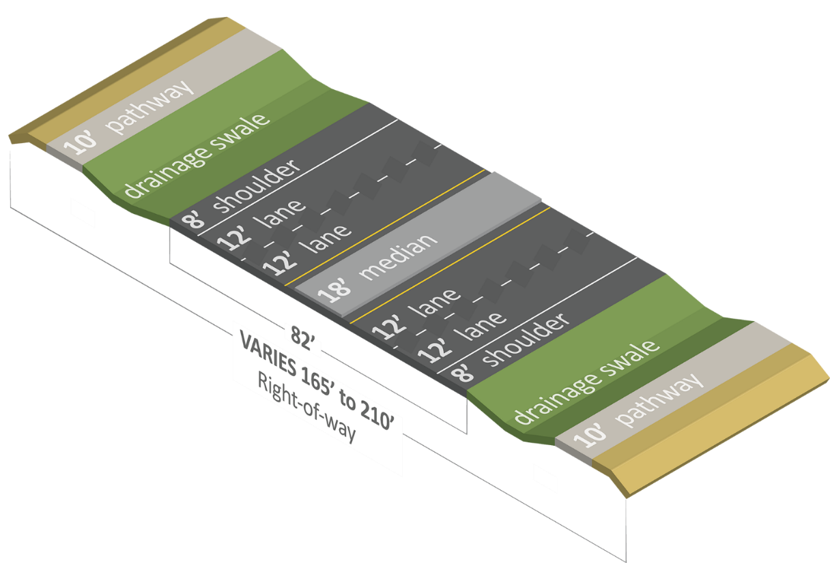
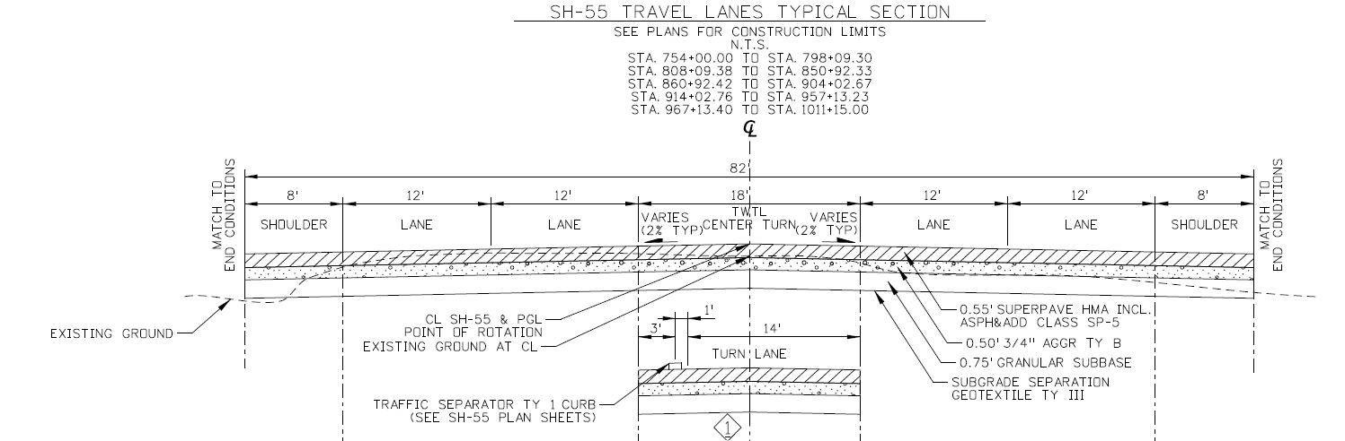
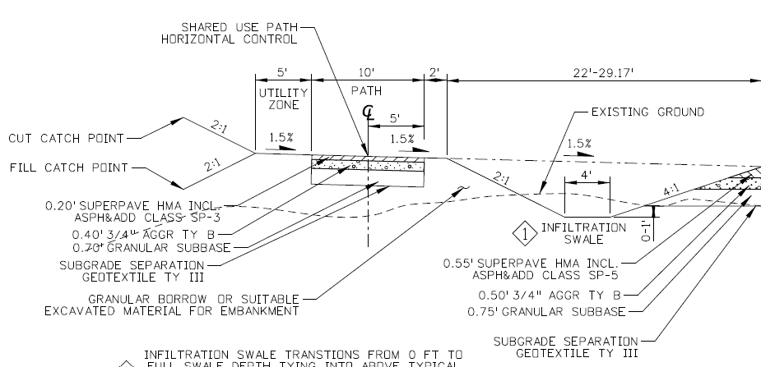
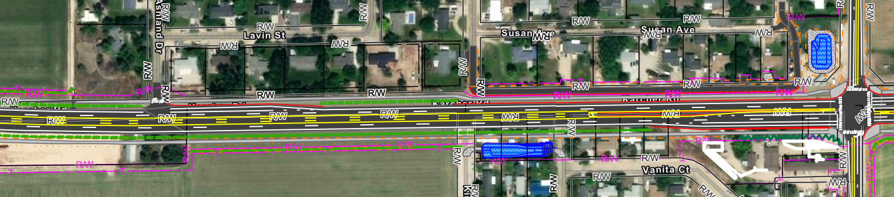
Proposed Improvements
SH-55 Widening
Quantities:
185,000 tons of granular subbase
210,000 tons of ¾" aggregate base
145,000 tons of HMA pavement
192,000 CY of excavation
Ashland Dr
10th Ave
New frontage road

Slide 10
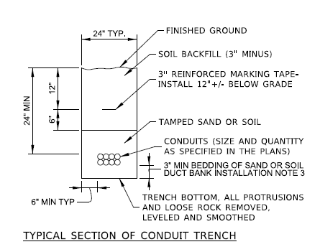
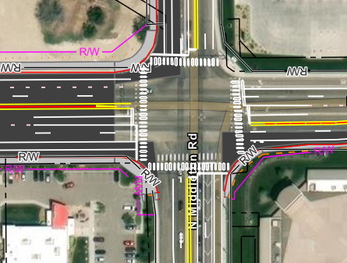
Proposed Improvements
ITS Equipment
Upgrading signal equipment and poles
10th, Indiana, Lake, Midway, Middleton
Conduit and Fiber
1-1/4”
Automatic Traffic Recorders (ATR)
Ashland Drive, East of Indiana Avenue
Quantities:
4 signal cabinets
132 vehicular signal heads
41 pedestrian signal heads
165,000 feet of conduit
2 ATR Sites

Slide 11
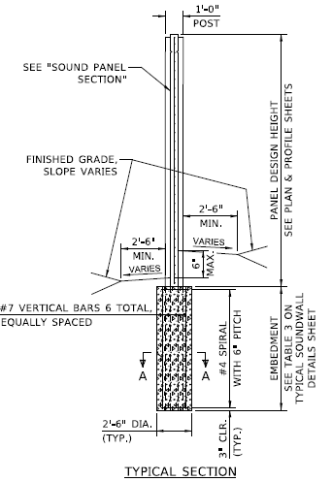
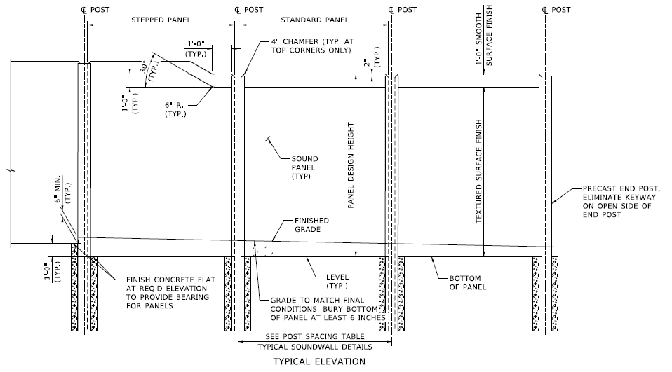
Proposed Improvements
Soundwalls
Locations
Lakeview Apartments (south of SH-55 and west of 10th Ave)
353ft long, 7ft height
Fieldcrest Village Subdivision (north of SH-55 and east of Lake Ave)
1,421ft long, 7ft height
Crestwood Estates Subdivision (north of SH-55 and east of Midway Rd)
1,407ft long, 6ft height
**Soundwalls will be constructed with post and panel
Quantities:
29,210 SF of Area
Lakeview = 3,070 SF
Fieldcrest = 13,608 SF
Crestwood 1 = 6,270 SF
Crestwood 2 = 6,262 SF

Slide 12
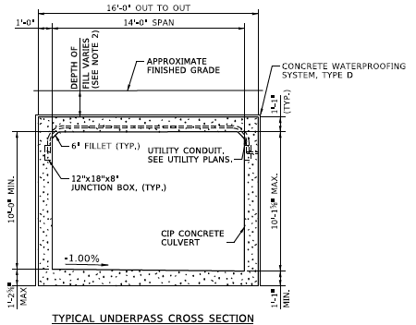
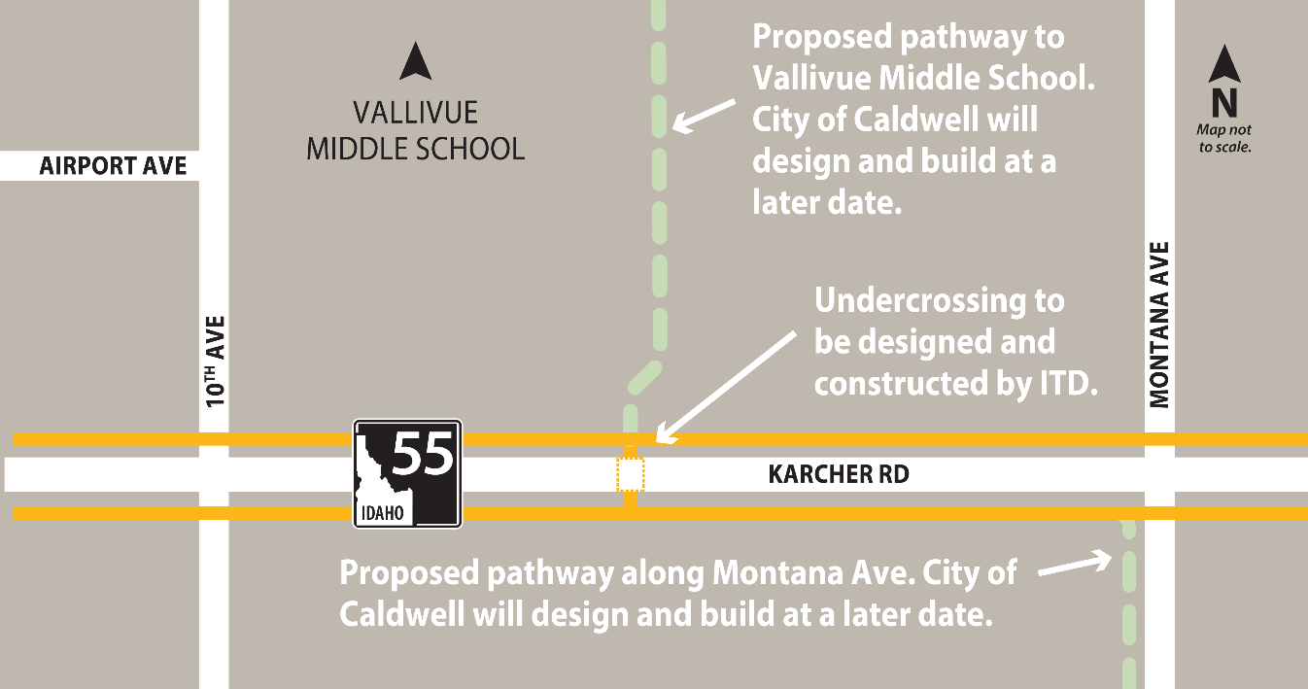
Proposed Improvements
Pedestrian Infrastructure
Detached Concrete Pathway
North and south sides of SH-55
10ft wide, 10 miles total
5” concrete pavement, 13” ¾-inch base
Pedestrian Undercrossing
170ft long, 16ft out-to-out
Cast-in-place concrete
Constructed in 2-stages
Quantities:
60,000 SY concrete sidewalk
85,000 lb metal reinforcement

Slide 13
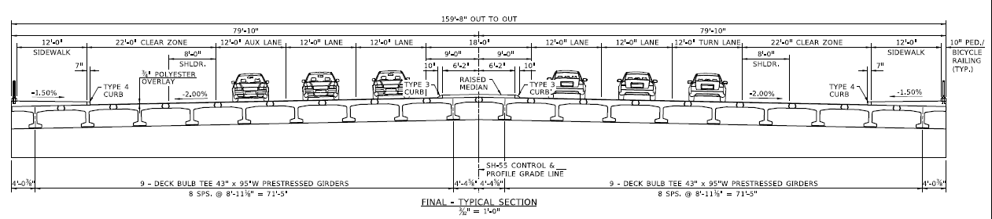
Proposed Improvements
Bridges
Widen or replace four canal bridges:
Elijah Drain, Wilson Drain, Phyllis Canal, Deer Flat Caldwell Canal
Work only during non-irrigation seasons
Anticipate two seasons to construct
Quantities:
2 precast stiffleg bridges (project will provide)
2,550ft of pre-stressed deck bulb tee girders
6,138ft of 16-inch steel shell pile footings
845 CY class 40 concrete

Slide 14
Traffic Impacts
Work will be allowed in the daytime and at night
One lane open in each direction during the daytime with shifting traffic patterns
Overnight lane closures and restrictions allowed
Flaggers directing traffic at intersections at night (10 p.m. to 5 a.m.)
Occasional overnight and weekend closures
Detours at Farmway Road, 10th Avenue, Montana Avenue and Lake Avenue
Speed limit reduced to 35 mph on gravel surfaces

Slide 15
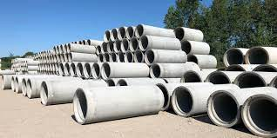
Adjacent Projects
KN 23336: I-84, Karcher Interchange
Construction: Started Spring 2024
Scope: Add a third westbound lane from the I-84 westbound off-ramp to Sundance Rd
Duration: 18 months
KN 22715A: SH-55 Irrigation Procurement Package
Procurement: Begins Fall 2024
Scope: Procure and store concrete culvert, irrigation pipe and minor concrete structures for installation in 22715
2 stiffleg structures, 3 concrete culverts
10,000ft of concrete irrigation pipe (ranges 8”- 48” diameter)
50 Irrigation boxes (5ft)
Duration: Nov 2024 – April 2026

Slide 16
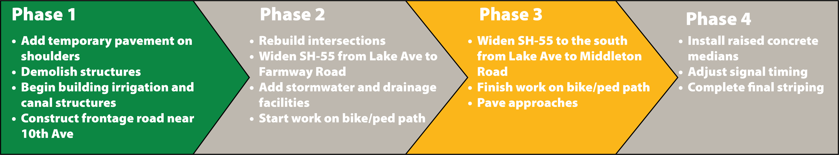
Construction Schedule
Finalize Bid Set & Prepare for Advertisement
July 2024
Advertisement for Bid
August 2024
4-week advertisement period
Construction Begins
November 2024
Work Complete
Fall 2027

Slide 17
Thank You
Project Website
http://ITDprojects.Idaho.gov/pages/55Farmway
ITD Design Contact: Erika Bowen
Project Manager, Design
erika.bowen@itd.idaho.gov
208-265-4312 ext. 7
ITD Construction Contact: Andrew Linder
Design/Construction Resident Engineer
andrew.linder@itd.idaho.gov
208-334-8331

