Slide 1
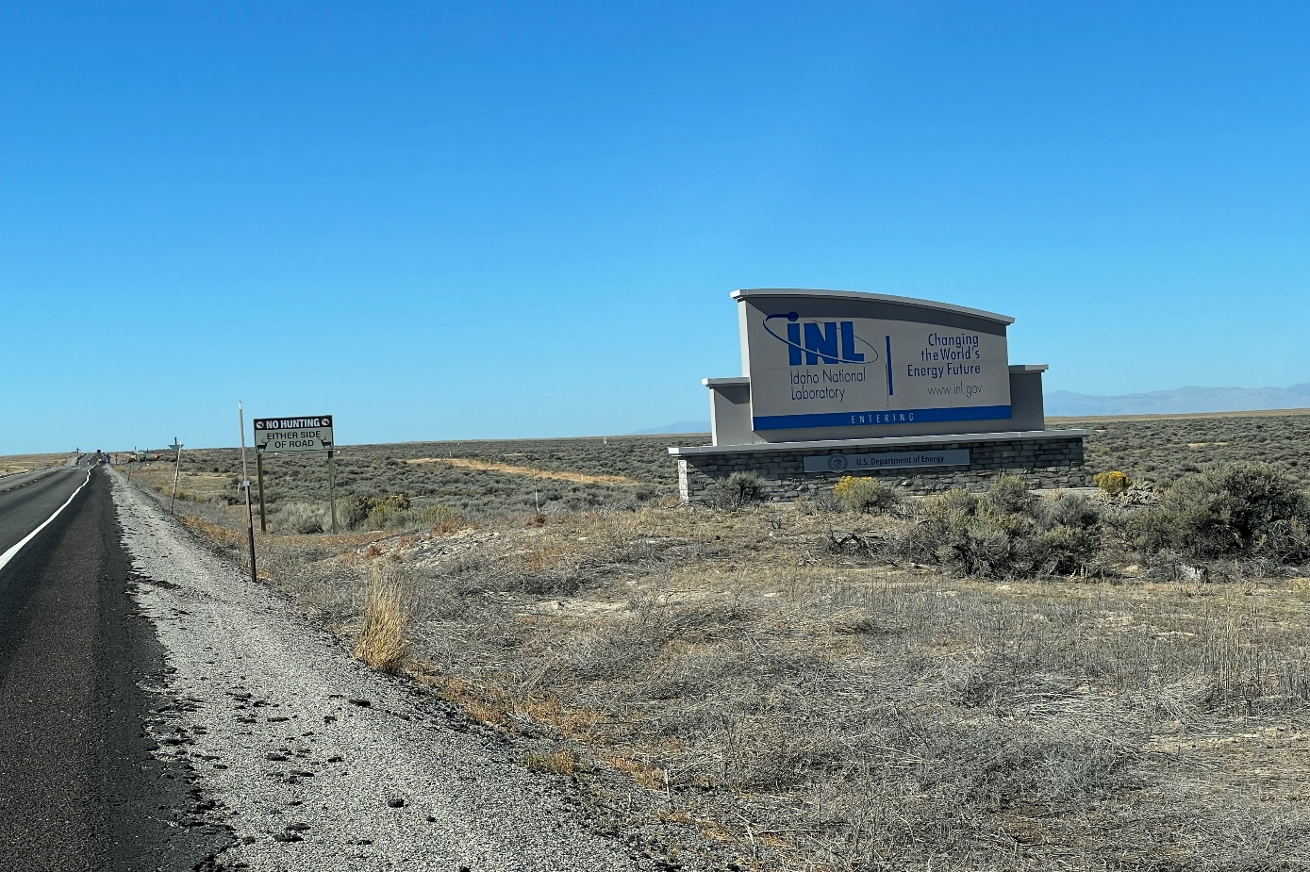
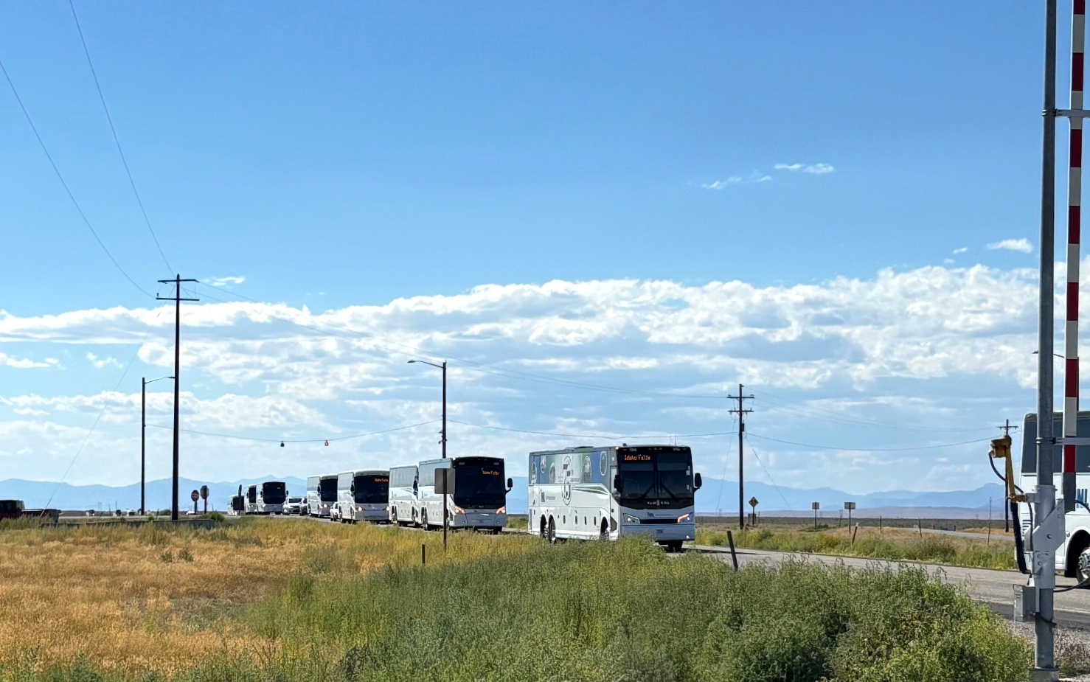
US-20, Bonneville Co Line to Idaho Falls
Key No. 23244

Slide 2
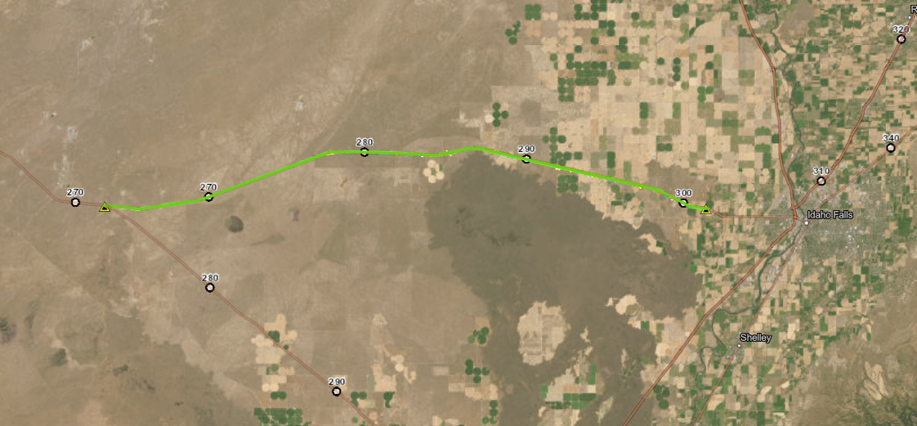
LOCATION:
KN 23244 US-20; Bonneville Co Line to Idaho Falls
Reconstruct 20 miles of existing US-20 from Two-Lane to Four-Lane
  Opportunities:
    40 miles of two-lane road
    Constructed primarily away from traffic
  Challenges:
    Peak Traffic from INL
    Rock excavation
      Over 400,000 CY (250,000 SY) of the 1,500,000 CY of excavation is potentially rock
BEGIN PROJECT MP 281
END PROJECT MP 301
Notes:
PROJECT 24149 IS BEING DESIGNED AS WE SPEAK

Slide 3
CONSTRUCTION PHASES:
KN 23244 US-20; Bonneville Co Line to Idaho Falls
In 1951, ITD acquired 400 feet of right of way (ROW) between the puzzle and Idaho Falls. Much of that ROW is farmed and grazed. Pivots and fences require adjustment. Construction is in the existing ROW.
MP 291 T0 301; Phase 1 : (EB lanes through more developed area):
  Residential, farming, ranching, and recreational approaches.
  Public Roads
  Rock Excavation
MP 291 TP 301: Phase 2 (WB lanes through more developed area):
  Residential, farming, ranching, and recreational approaches.
  Public Roads
  Rock Excavation
MP 281 TO 291: Phase 1: (EB lanes through less developed area)
  Farming, ranching, and recreational approaches.
  Rock Excavation
MP 281 TO 291: PHASE 2: (WB lanes through less developed area):
  Farming, ranching, and recreational approaches.
  Rock Excavation
MP 281 TO 291– Phase 2
Westbound lanes on existing US-20. Traffic on new EB lanes during construction.
MP 291 T0 301– Phase 2
Westbound lanes north of existing US-20. Traffic on new EB lanes during construction.
MP 281 TO 291– Phase 1
Eastbound lanes south of existing US-20. Traffic on existing during construction.
MP 291 T0 301– Phase 1
Eastbound lanes south of existing US-20. Traffic on existing during construction.

Slide 4
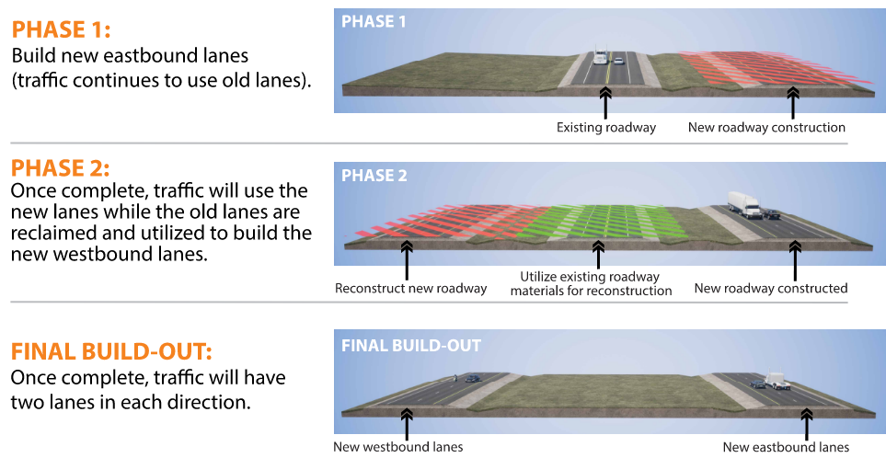
PM 291 TO 301: KN 23244 US-20; Bonneville Co Line to Idaho Falls

Slide 5
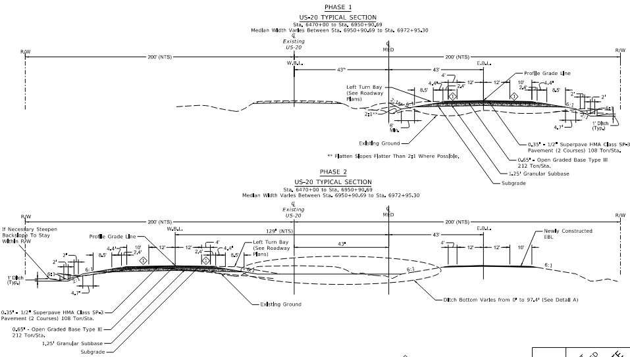
MP 291 TO 301:
KN 23244 US-20; Bonneville Co Line to Idaho Falls
Key Features:
Nearest Idaho Falls to be constructed first.
Constructing South and then north of the existing US-20
Existing US-20 to be excavated and utilized while constructing the North lanes

Slide 6
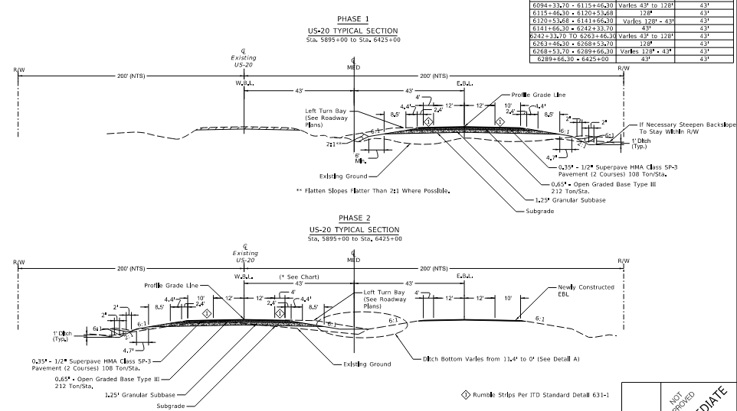
MP 281 TO 291:
KN 23244 US-20; Bonneville Co Line to Idaho Falls
Key Features:
Further from Idaho Falls to be constructed second.
Constructing South and then constructing on the existing US-20 alignment
Existing US-20 to be excavated and used with phase 2

Slide 7
Mass Balance:
KN 23244 US-20; Bonneville Co Line to Idaho Falls
Approximate Mass Balance Results for the Phases Include:
MP 291 TO 301 Phase 1: 70,000 CY excess excavated material to be used on MP 281-291 Phase 1;
MP 291 TO 301 Phase 2: 213,000 CY (including approximately 18,000 CY of asphalt pavement) of excess material is produced. Approximately 100,000 CY to be used on MP 281-291, Phase 1. The remainder to be stockpiled on the west end of the project for future projects.
MP 281 TO 291 Phase 1: Uses 170,000 CY from MP 291-301
MP 281 TO 291 Phase 2: Excess excavated material to be stockpiled on the west end of the project for future phases.
MP 281 TO 291 – Phase 2
Westbound lanes on existing US-20. Traffic on new EB lanes during construction.
MP 291 TO 301 – Phase 2
Westbound lanes north of existing US-20. Traffic on new EB lanes during construction.
MP 281 TO 291 – Phase 1
Eastbound lanes south of existing US-20. Traffic on existing during construction.
MP 291 TO 301 – Phase 1
Eastbound lanes south of existing US-20. Traffic on existing during construction.

Slide 8
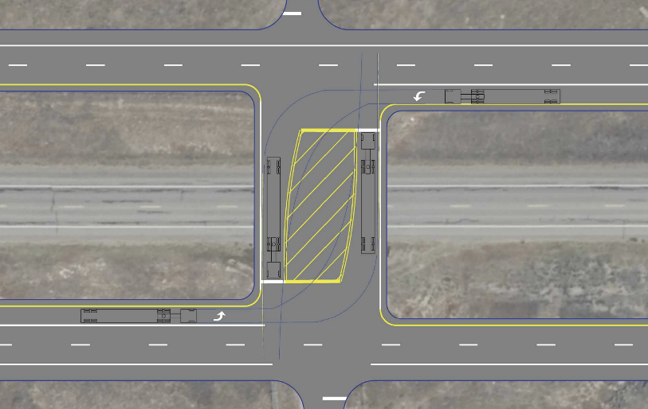
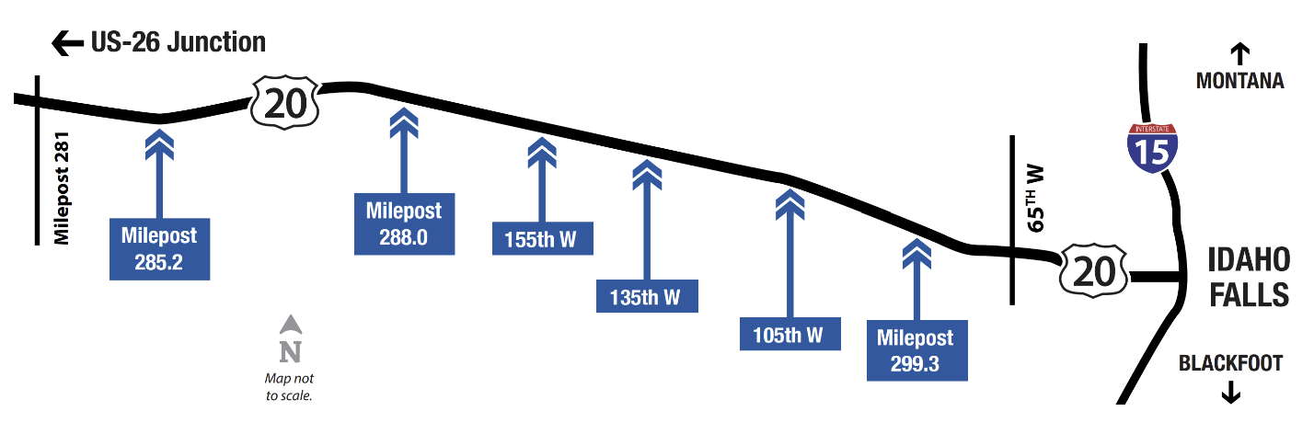
Intersections / Refuge
KN 23244 US-20, Bonneville Co Line to Idaho Falls
Key Features:
Improves safety
Wide enough for truck and trailer
Deceleration lanes
Reduces conflict point
Intersection
Refuge example.

Slide 9
Approximate Quantities
KN 23244 US-20, Bonneville Co Line to Idaho Falls
Roadway
  Excavation ~1,500,000 CY (425,000 CY Rock Excavation)
  HMA SP3 ~231,000 TON
  ¾” Aggregate (Open Graded Base) ~400,000 TON
  Granular Subbase ~1,137,000 TON
  Culverts ~23,000 FT
Additional Considerations
  2 construction seasons (Completed fall of 2027)
  Six Intersection/Refuge Locations
  Two Crossover locations
  RWIS, ATR, Luminaire Relocation

