Slide 1
Name a Snowplow
Idaho Transportation Department
Notes:
Today we are going to talk about winter safety and how everyone can stay safe while traveling. Then we will participate in a special contest put on by the Idaho Transportation Department, which keeps highways and interstates safe and open for travel.

Slide 2
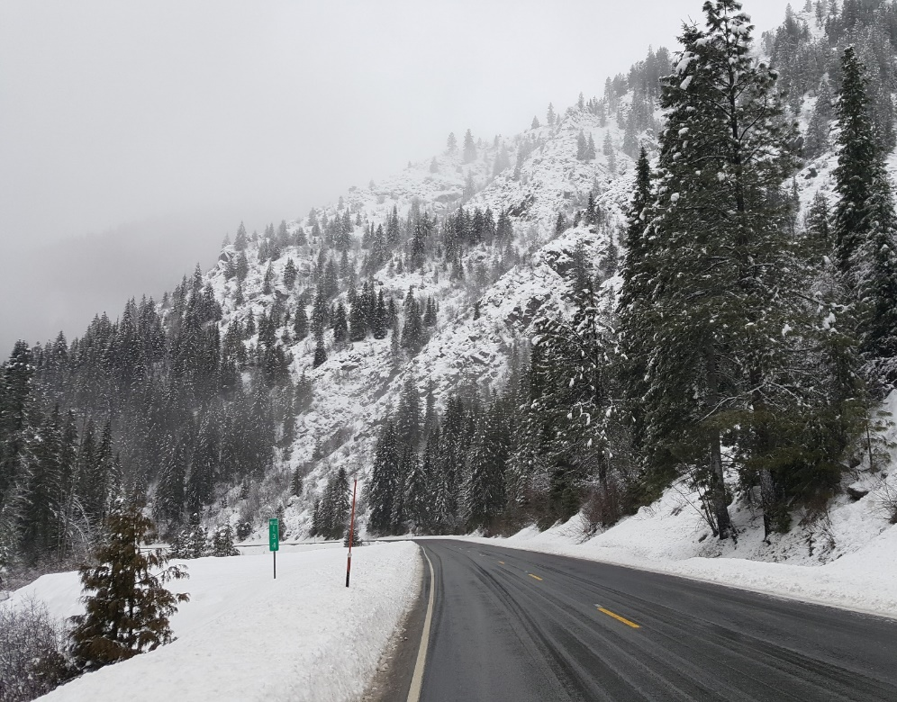
Highways during winter
Highways are important so people can get where they need to go like school and work when they need to
Ensure people have access to goods like groceries
Quick access for police, ambulance and fire
Goal to keep roads snow-free most of the time during a storm
Notes:
You may not have thought about it, but you probably drive, walk or bike somewhere every day. Highways are important so people like you can get where you need to go, when you need to go.
Highways are also used to transport things like groceries that we need every day.
They make sure first responders can get to emergencies quickly so they can help people.
With all that in mind, there are many agencies like the Idaho Transportation Department that work hard to keep roads safe and snow-free in the winter during storms by using snowplows.

Slide 3
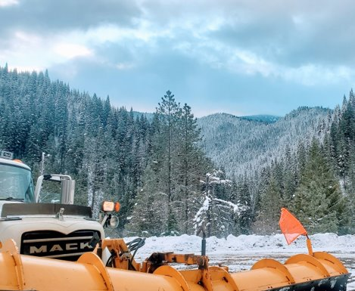
Name a snowplow
Learn about how plows keep everyone safe and what you can do as soon-to-be drivers
Offer a name to help you remember your safe driving tips and possibly get naming rights for a plow in your area
Two will be named in your region this year
Names due by Oct. 31
Winners announced by the end of the year
Notes:
This year our classroom has been invited to learn about how to be safe around plows as they keep our roads clear of snow.
Then we'll get to pick a name as a group so that everyone remembers to be safe on the road.
Of all the names submitted by classrooms like ours, only two will be picked and given to plows in our area.
We'll pick our name by the end of the month, and we'll hear back by the end of the year if our name was chosen.

Slide 4
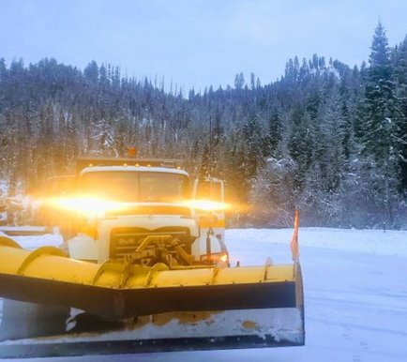
Plowing by the numbers
Winter maintenance means plowing
Plowing pushes snow off the road
In Idaho, there are 425 plows in use on highways and interstates
511 is an app to help you stay up to date on road conditions
Notes:
Drivers use trucks with plows to keep snow off the road.
There are more than 425 plows in Idaho keeping highways and interstates snow-free.
Even with that many plows, it's hard to keep up during big storms, so you can also use the app 511 to know when roads are covered in snow or even closed.

Slide 5
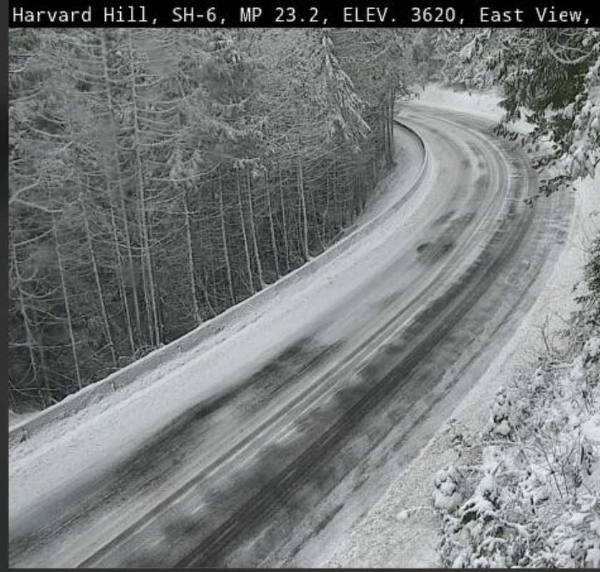
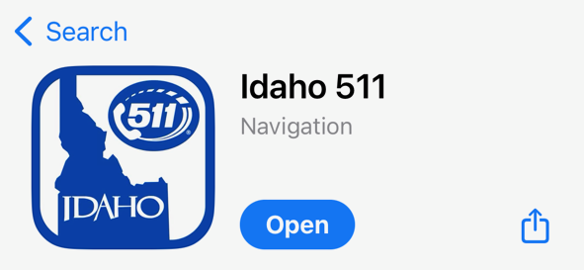
Idaho 511
Idaho 511 is a resource that provides real-time traffic updates, road conditions and alerts to help travelers plan their routes safely.
You can use the system three different ways by:
Calling 511 from anywhere within Idaho
Visiting the website at 511.idaho.gov
Downloading the Idaho 511 app to any smart device
Notes:
511 is a resource that is available 24/7 for travelers to learn about traffic and road conditions, as well as receive alerts, so people can plan for safe trips.
It’s an app you can download, a website you can visit and a phone number you can call.
There are cameras all across the state so you can actually see in real time what conditions are like. Conditions are updated at all hours of the day and night.

Slide 6
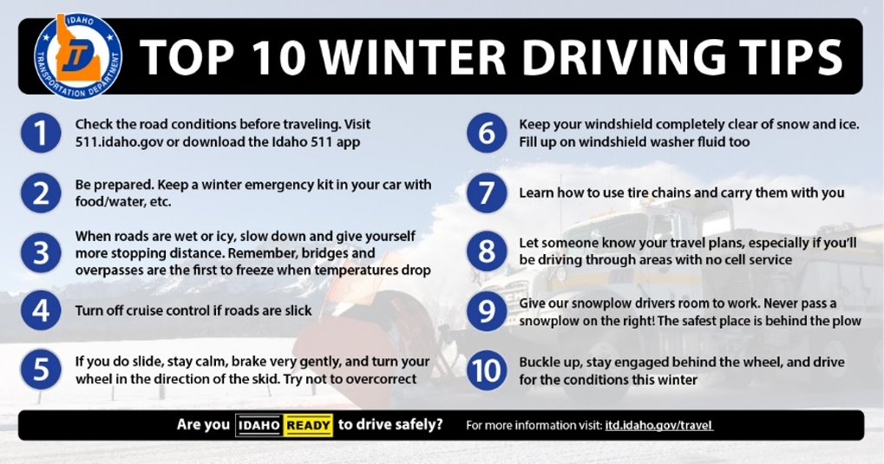
Notes:
Checking 511 is the #1 top tip for traveling safely in the winter.
You should also have an emergency kit in your car in case you get stuck – we'll talk about that more on the next slide.
In winter, roads can be wet or icy, so it's important to remember to slow down so you have more distance to stop if needed. Remember, bridges and overpasses are the first to get icy.
Don't use cruise control if roads are slick.
If you do slide, stay calm, brake very gently and turn your wheel in the direction of the skid. Try not to overcorrect.
To make sure you can see, clear your windshield completely of snow and ice. Make sure you have enough washer fluid too.
Learn how to use chains and carry them with you.
Let someone know of your travel plans, especially if you'll be driving through areas without cell service.
Give snowplow drivers room to work. We'll go over in more detail what this means.
Like always, wear your seatbelt, put away distractions so you can be engaged and drive for conditions.

Slide 7
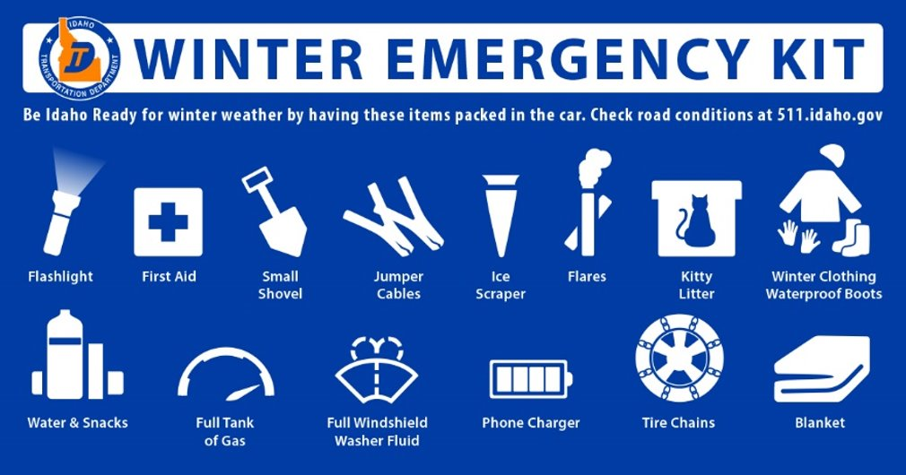
Notes:
Here are some suggested items to keep in your car: flashlight, first aid kit, a small shovel, jumper cables, ice scraper, flares, kitty litter, extra winter clothing and boots, water and snacks, extra gas, plenty of windshield washer fluid, phone charger, tire chains and a blanket.

Slide 8
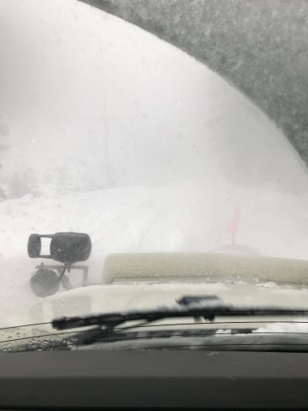
Challenges for drivers
Being a plow driver isn’t easy.
Most people think the scariest thing about the job is the weather, but sharing the road with other drivers can be scary too.
Plow drivers, like everyone, want to get home safely to their families.
Notes:
Once you start driving and see plows, it’s important to know what it’s like to drive these big machines.
Most people think the scariest thing about being a plow driver is the weather, but sharing the road with other drivers can be scary too, especially when they’re looking at their phones instead of the road or driving too fast.
Just like you, plow drivers want to get home safely to their families – let's talk about what to do, and what not to do, around plows when we see them on the road.

Slide 9
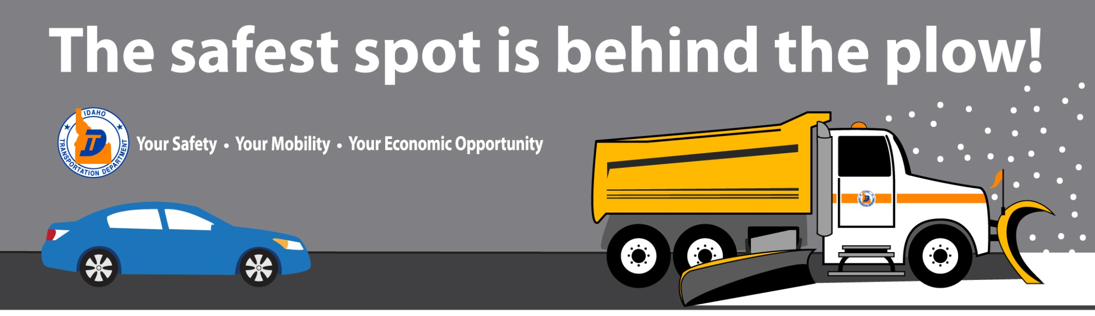
Notes:
Stay behind the plow - the road is always nicer (and safer) when the snow has been pushed off.

Slide 10
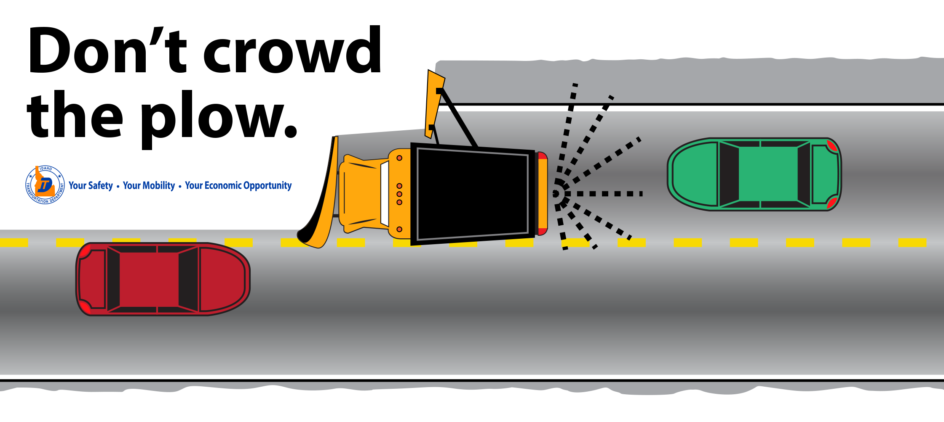
Notes:
Don't crowd the plow! Give them room to work.
If you're approaching a plow like the red car, don't hog the center line – scoot over so the plow can clear the middle of the road too.
If you're following a plow like the green car, stay back so you have time to stop if you need to.

Slide 11
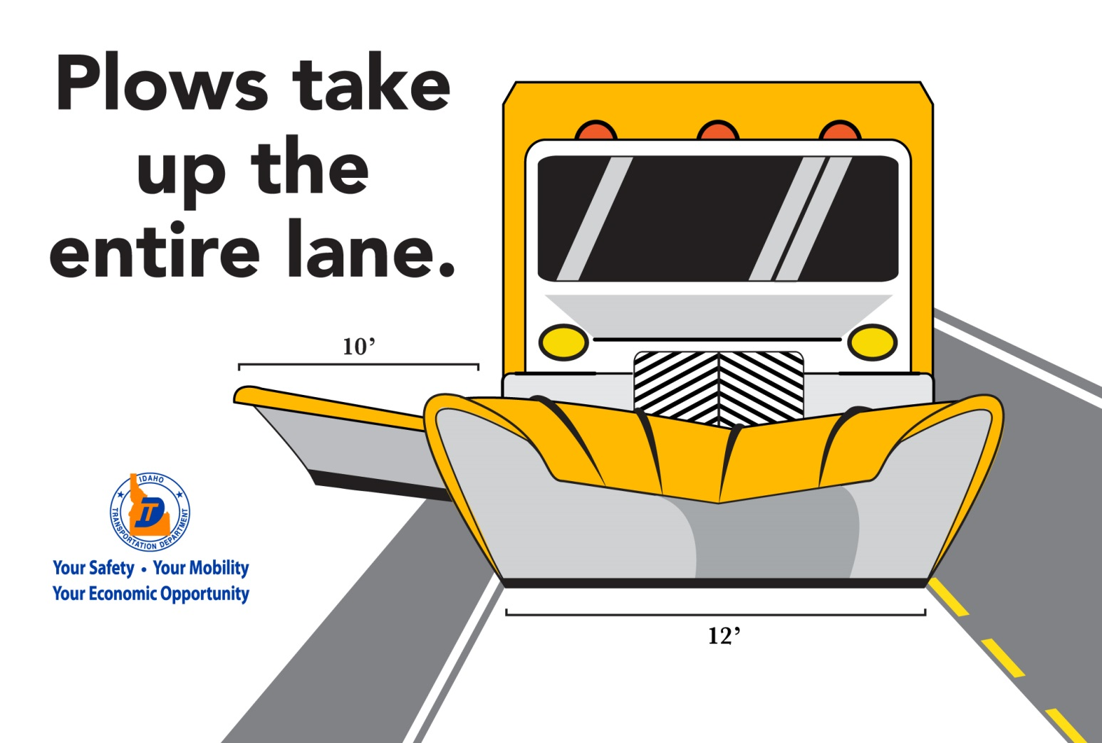
Notes:
Here's another reason to not hog the center line. Plows take up the entire lane, with the front plow measuring at 12 feet wide. Also notice the wing plow on the side of the truck that is 10 feet long. These plows need space to get the job done!

Slide 12
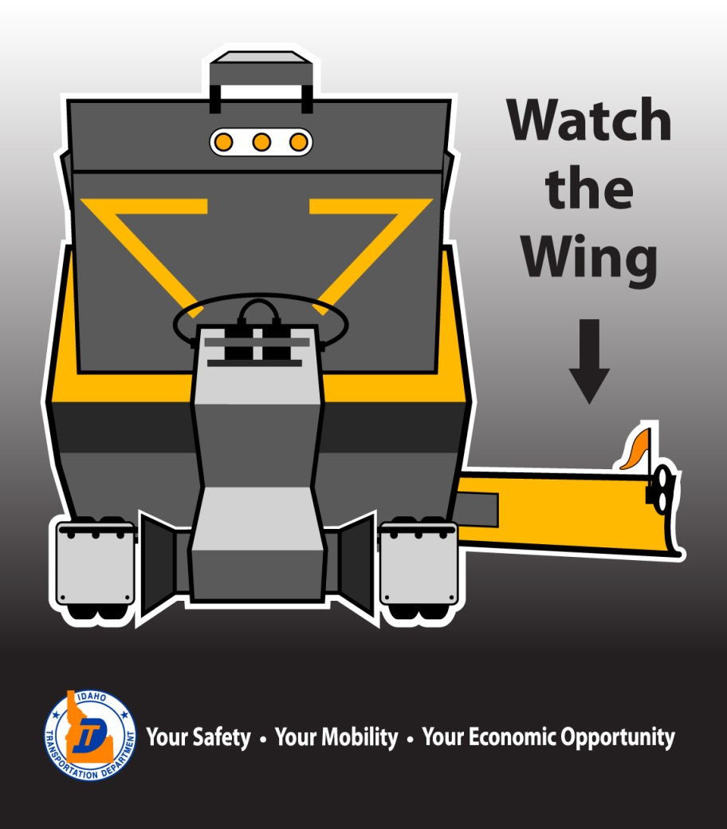
Notes:
Again, here's that wing plow, but from behind, how you normally see it. While the wing plow will have lights and flags to remind you it's there, it's can be hard to see during storms as the snow gets pushed up and over the blade. This is why you don't pass on the right – if you do, there's a good chance you'll run into the wing plow on the right side and possibly get hurt.

Slide 13
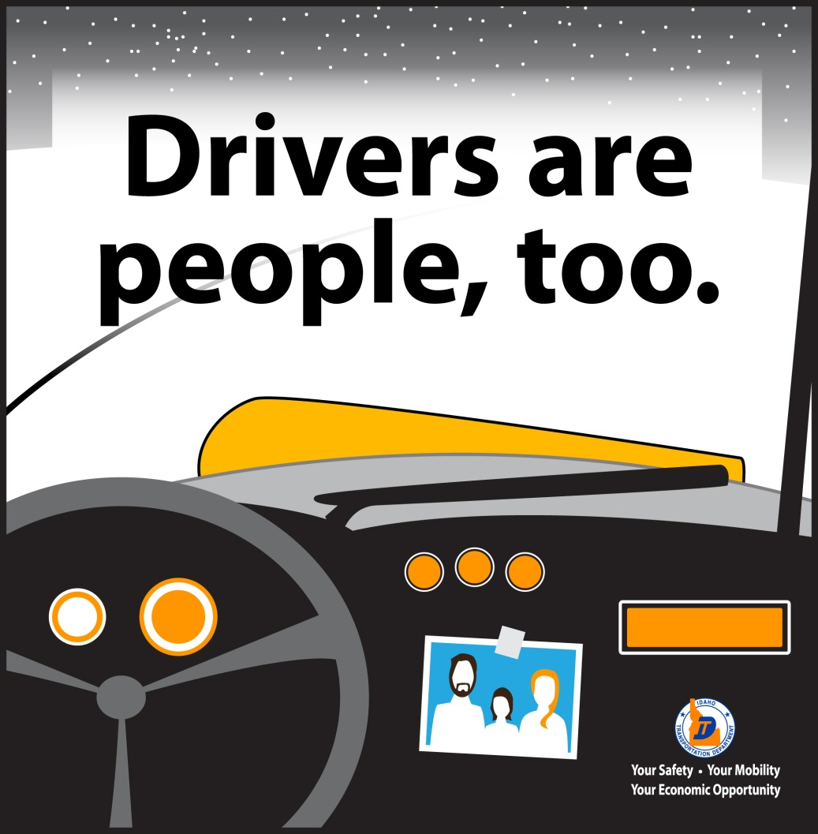
Notes:
Even though you can't see them, the people in the plows are just like you. Help them get home safely by remembering all of these tips and sharing them with others.

Slide 14

Putting it all together
Notes:
Play the 25-second video to summarize all the tips.
https://youtu.be/Ya0YH0q5Z9Y

Slide 15
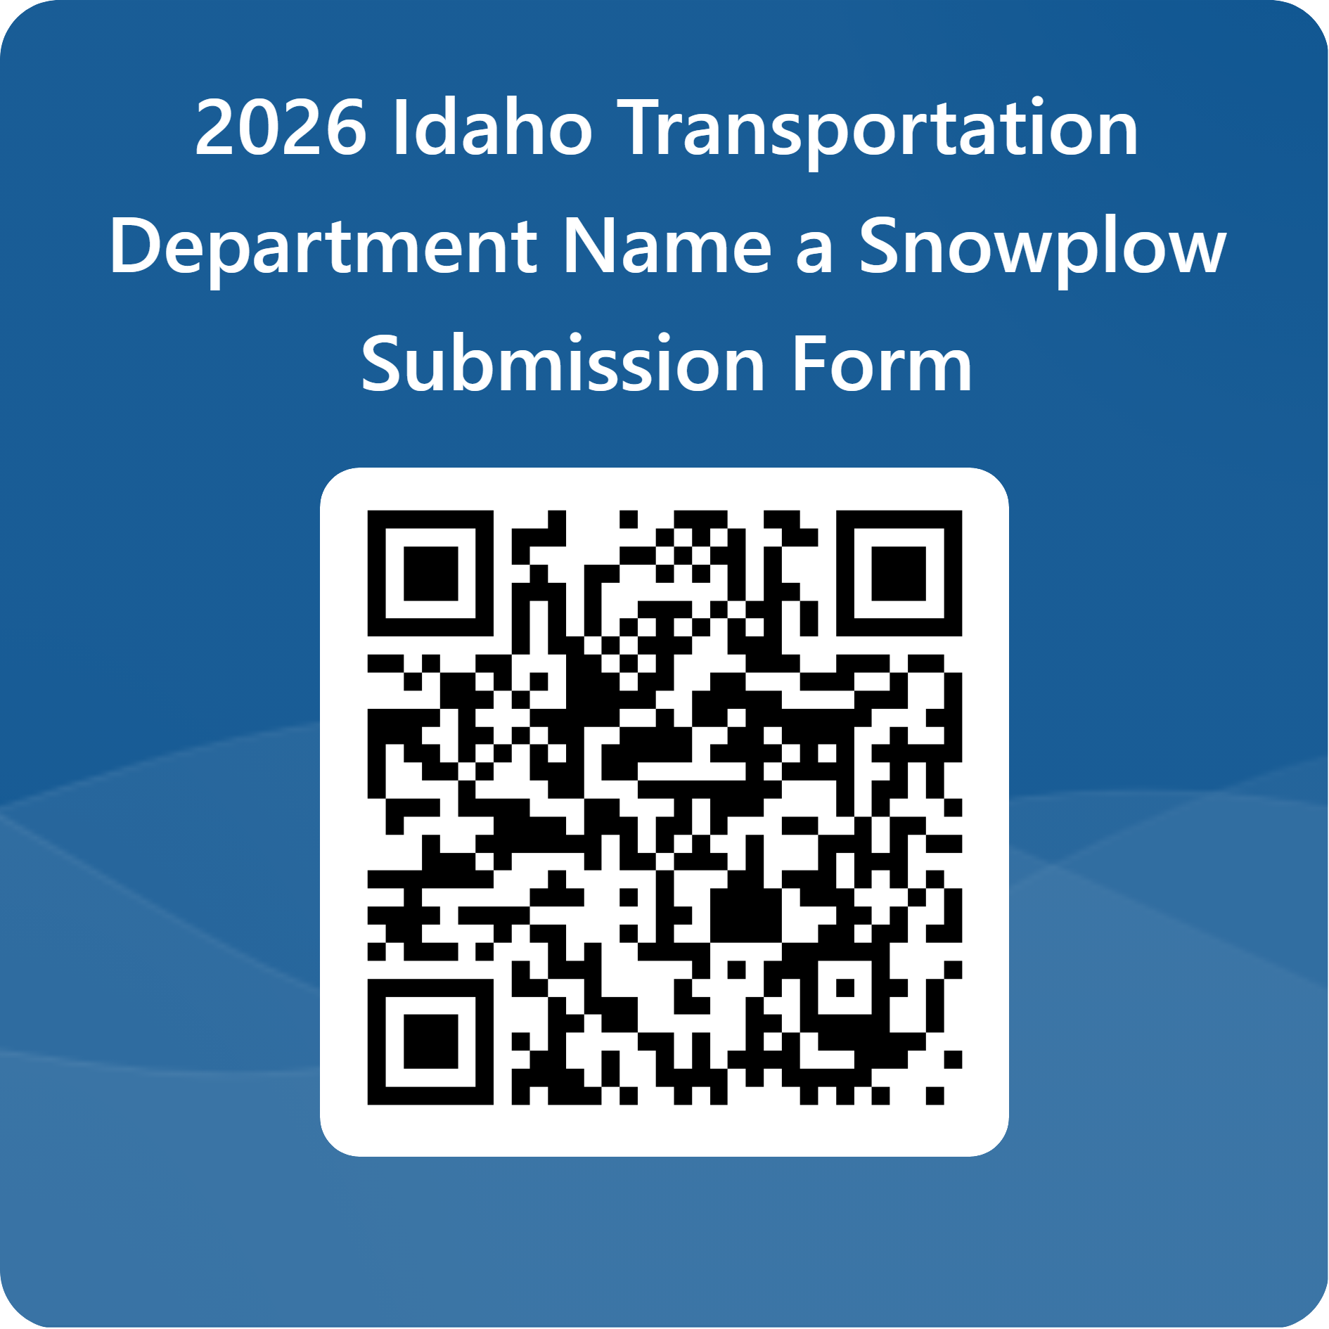
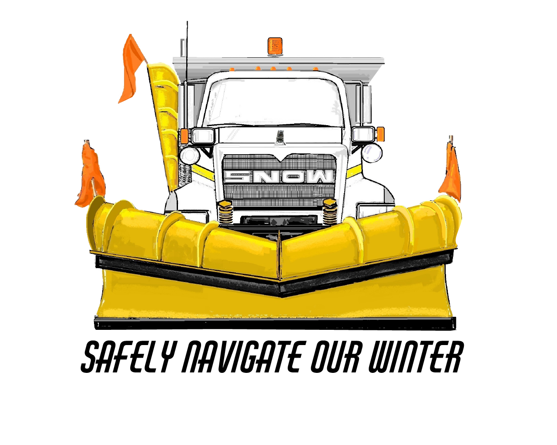
Let's pick a name
Let's have fun and name a plow so others remember how to be safe around them
Names limited to 15 characters
One per classroom
Submissions due by Oct. 31 – use the QR code!
Winners announced by the end of the year
Notes:
Now that we know how to be safe around plows, let's pick a name!
Names have to be 15 characters or less to fit on the plow. We only get to pick one name, and we have to do it by the end of October. Then at the end of the year we'll find out if we won, and our named plow will visit the school!

