Slide 1
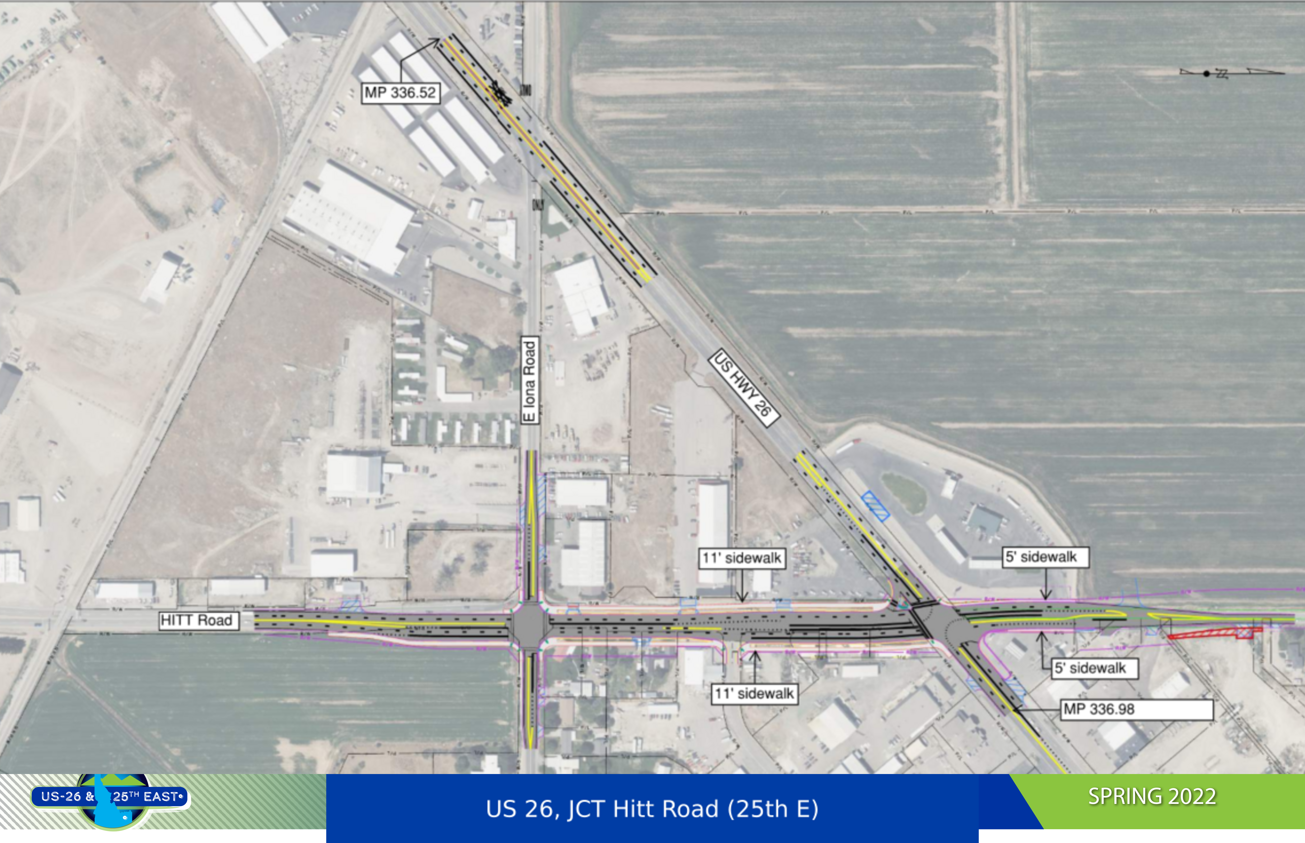
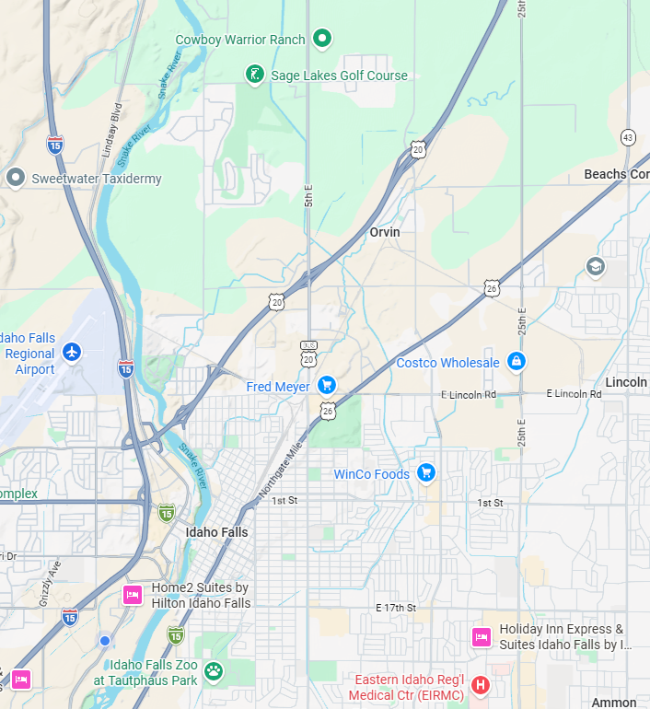
KN21923
Federal Aid Project
US 26,
JCT Hitt Road
(25th E)
Bonneville County
Project 21923 Location NE of Idaho Falls
Notes:
[Sources]
- KN21923_US-26 & 25th E Public Hearing Summary_Final_2022-05-16.pdf, page 20 (user-provided preferred-alternative plan image).
- d71cdd7c-cc53-45ac-9822-3ab5a7621467.png (user-provided title-slide location map).

Slide 2
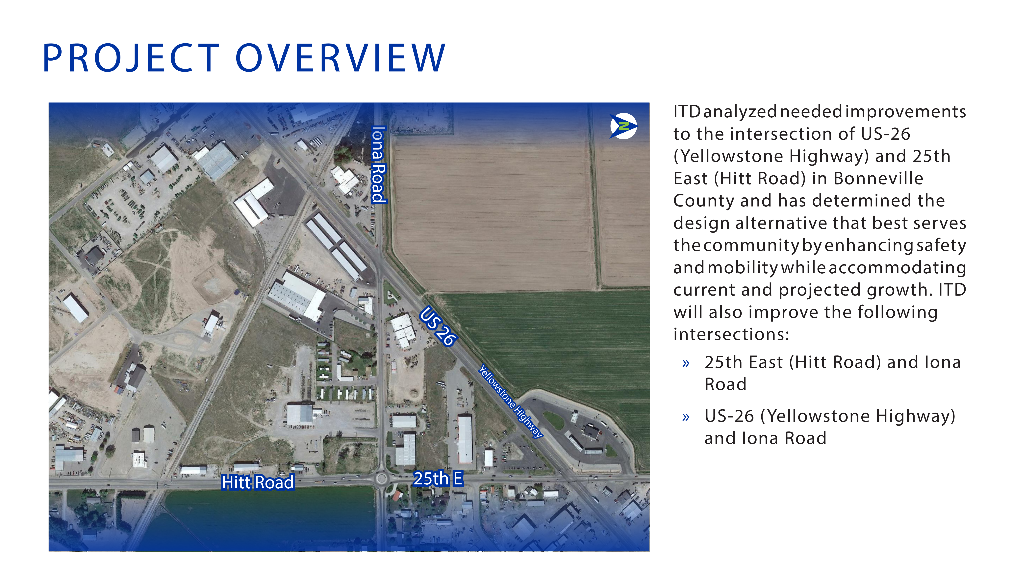
Notes:
[Sources]
- KN21923_US-26 & 25th E Public Hearing Summary_Final_2022-05-16.pdf, page 17 (user-provided source).

Slide 3
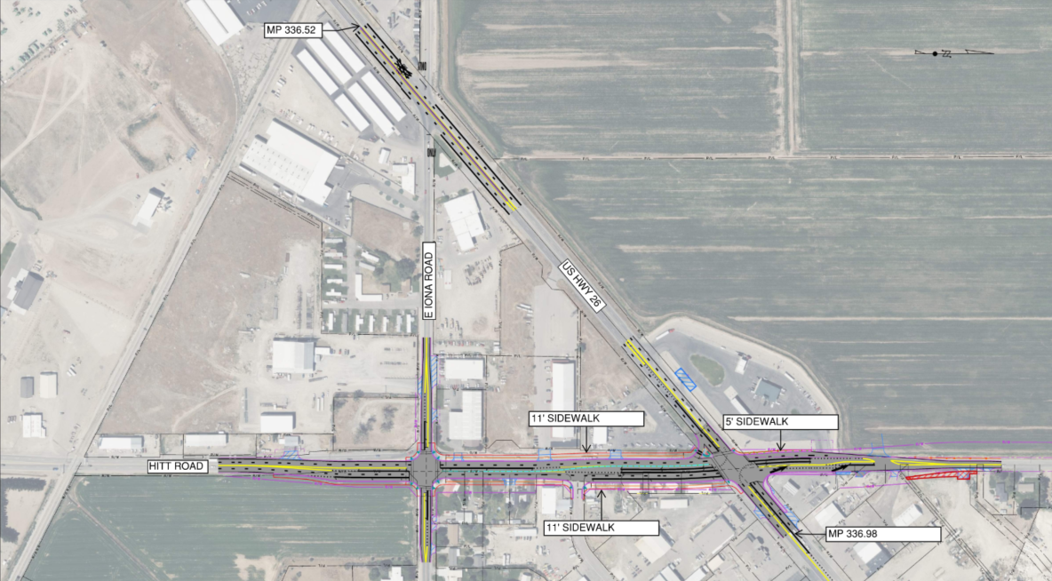
PREFERRED ALTERNATIVE 2
Shifts Hitt Road East
Notes:
[Sources]
- KN21923_US-26 & 25th E Public Hearing Summary_Final_2022-05-16.pdf, page 20 (user-provided source).
- 3e02c188-4819-47e9-81d9-a3aa3b135ebf.png (user-provided slide 5 replacement image).

Slide 4
PROJECT IMPROVEMENTS
SAFETY
Installing a median barrier along US 26 to restrict access at Iona Road to right-in/right-out movements.
Improve access management by consolidating approaches and increasing their distance from intersections.
Construct a pedestrian refuge island at the US 26/Hitt Road intersection.
Increased roadway capacity to improve safety
MOBILITY AND ACCESS
Adding turn lanes and additional through lanes at the US 26/Hitt Road and Iona Road/Hitt Road intersections.
Install a traffic signal at the Iona Road/Hitt Road intersection. Deleting the current roundabout.
Construct sidewalks and crosswalks throughout the corridor.
Add a dedicated slip lane for eastbound-to-southbound traffic.
Add lanes on Hitt Road and Iona Road increasing capacity
Install upgraded signals at Iona Rd and US-26 providing an opportunity to synchronize signal timing and minimize delays.

Slide 5
Quantities & Considerations
Approximate Quantities of large bid items
Superpave HMA SP-3 (11,000 TON)
¾” Aggregate Type B for Base (18,900 TON)
18 Paved Approach's
Sidewalk, Driveway, & Curb Ramp (4,500 SY) Concrete
Curb, Gutter, Traffic Separator Type 1 (7,500 ft) Concrete
Signals, Controllers, Cabinets, Ped poles, Intersection Detection Equip, Illumination & Misc. Electrical Equipment Note: This equipment will need to be ordered in advance to meet project schedule.
Coordination with
Emergency Services
Bonneville School District & Business’s in the project area
All utility companies in the project limits – Falls Water has requested contractor Coordination for up to a 14 day max time period for installation of new waterline.
Other
Maintain access to local business’s
Irrigation work (Culverts and drainage)
Limited night work for staging purposes at north side of Hitt & 26 intersection
Contract Requires Davis Bacon Wages & Buy America provisions

Slide 6
PROJECT SCHEDULE
Advertisement for Bid
Work Complete
December 2026
September 2027
1
2
3
April 2027
Construction Begins
Notes:
I just want to thank my team at ITD & Horrocks Engineering for all their support in coming together to finish this much needed Safety & Capacity project. Thank you.

